Slide 1
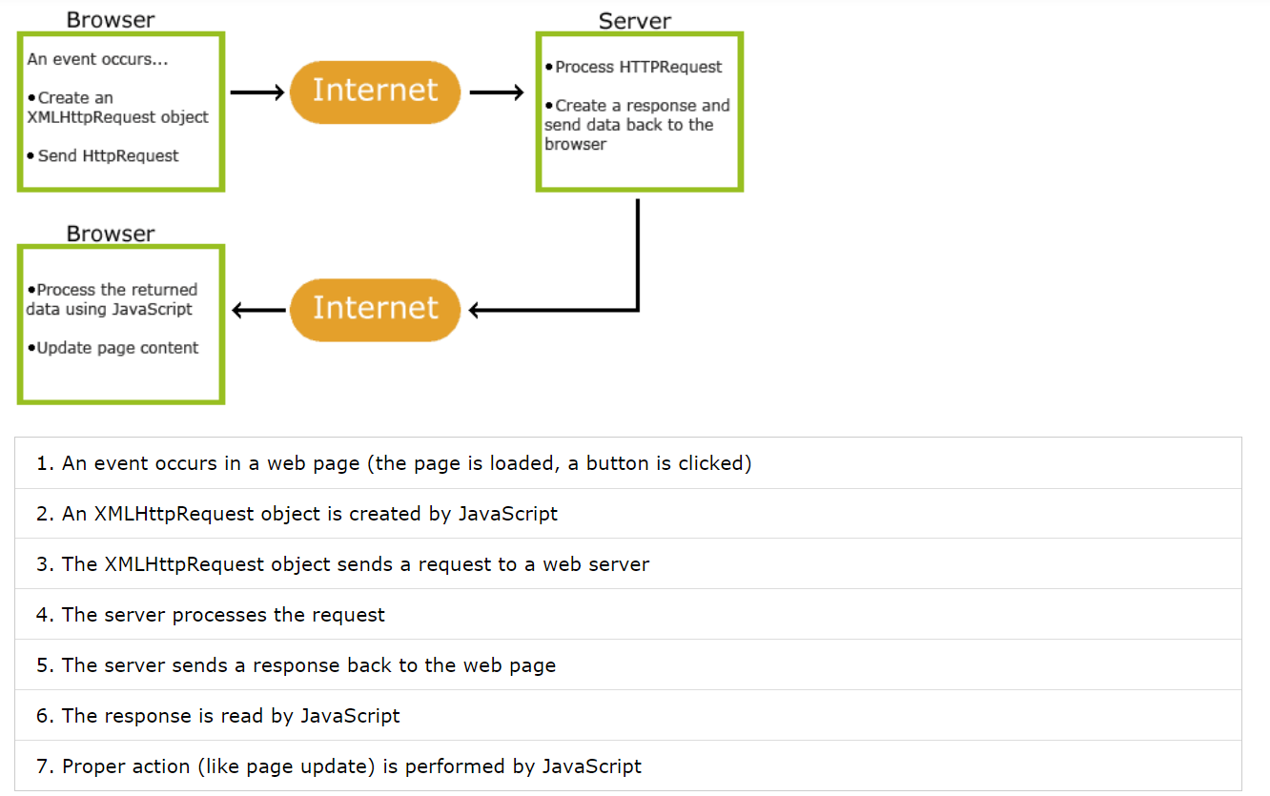
How Ajax works (w3schools):

Slide 2
